Slide 1
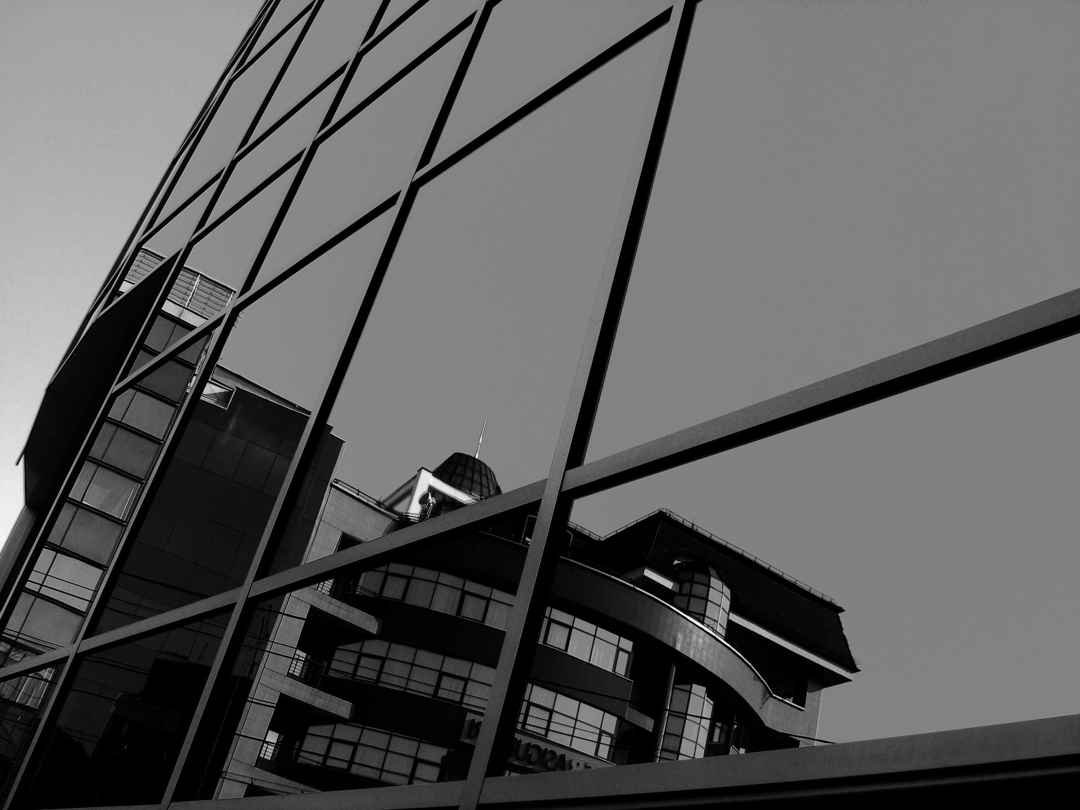
EFFICIENT PROJECT MANAGEMENT FOR AGILE TEAMS
Agile Board CLI Application

Slide 2
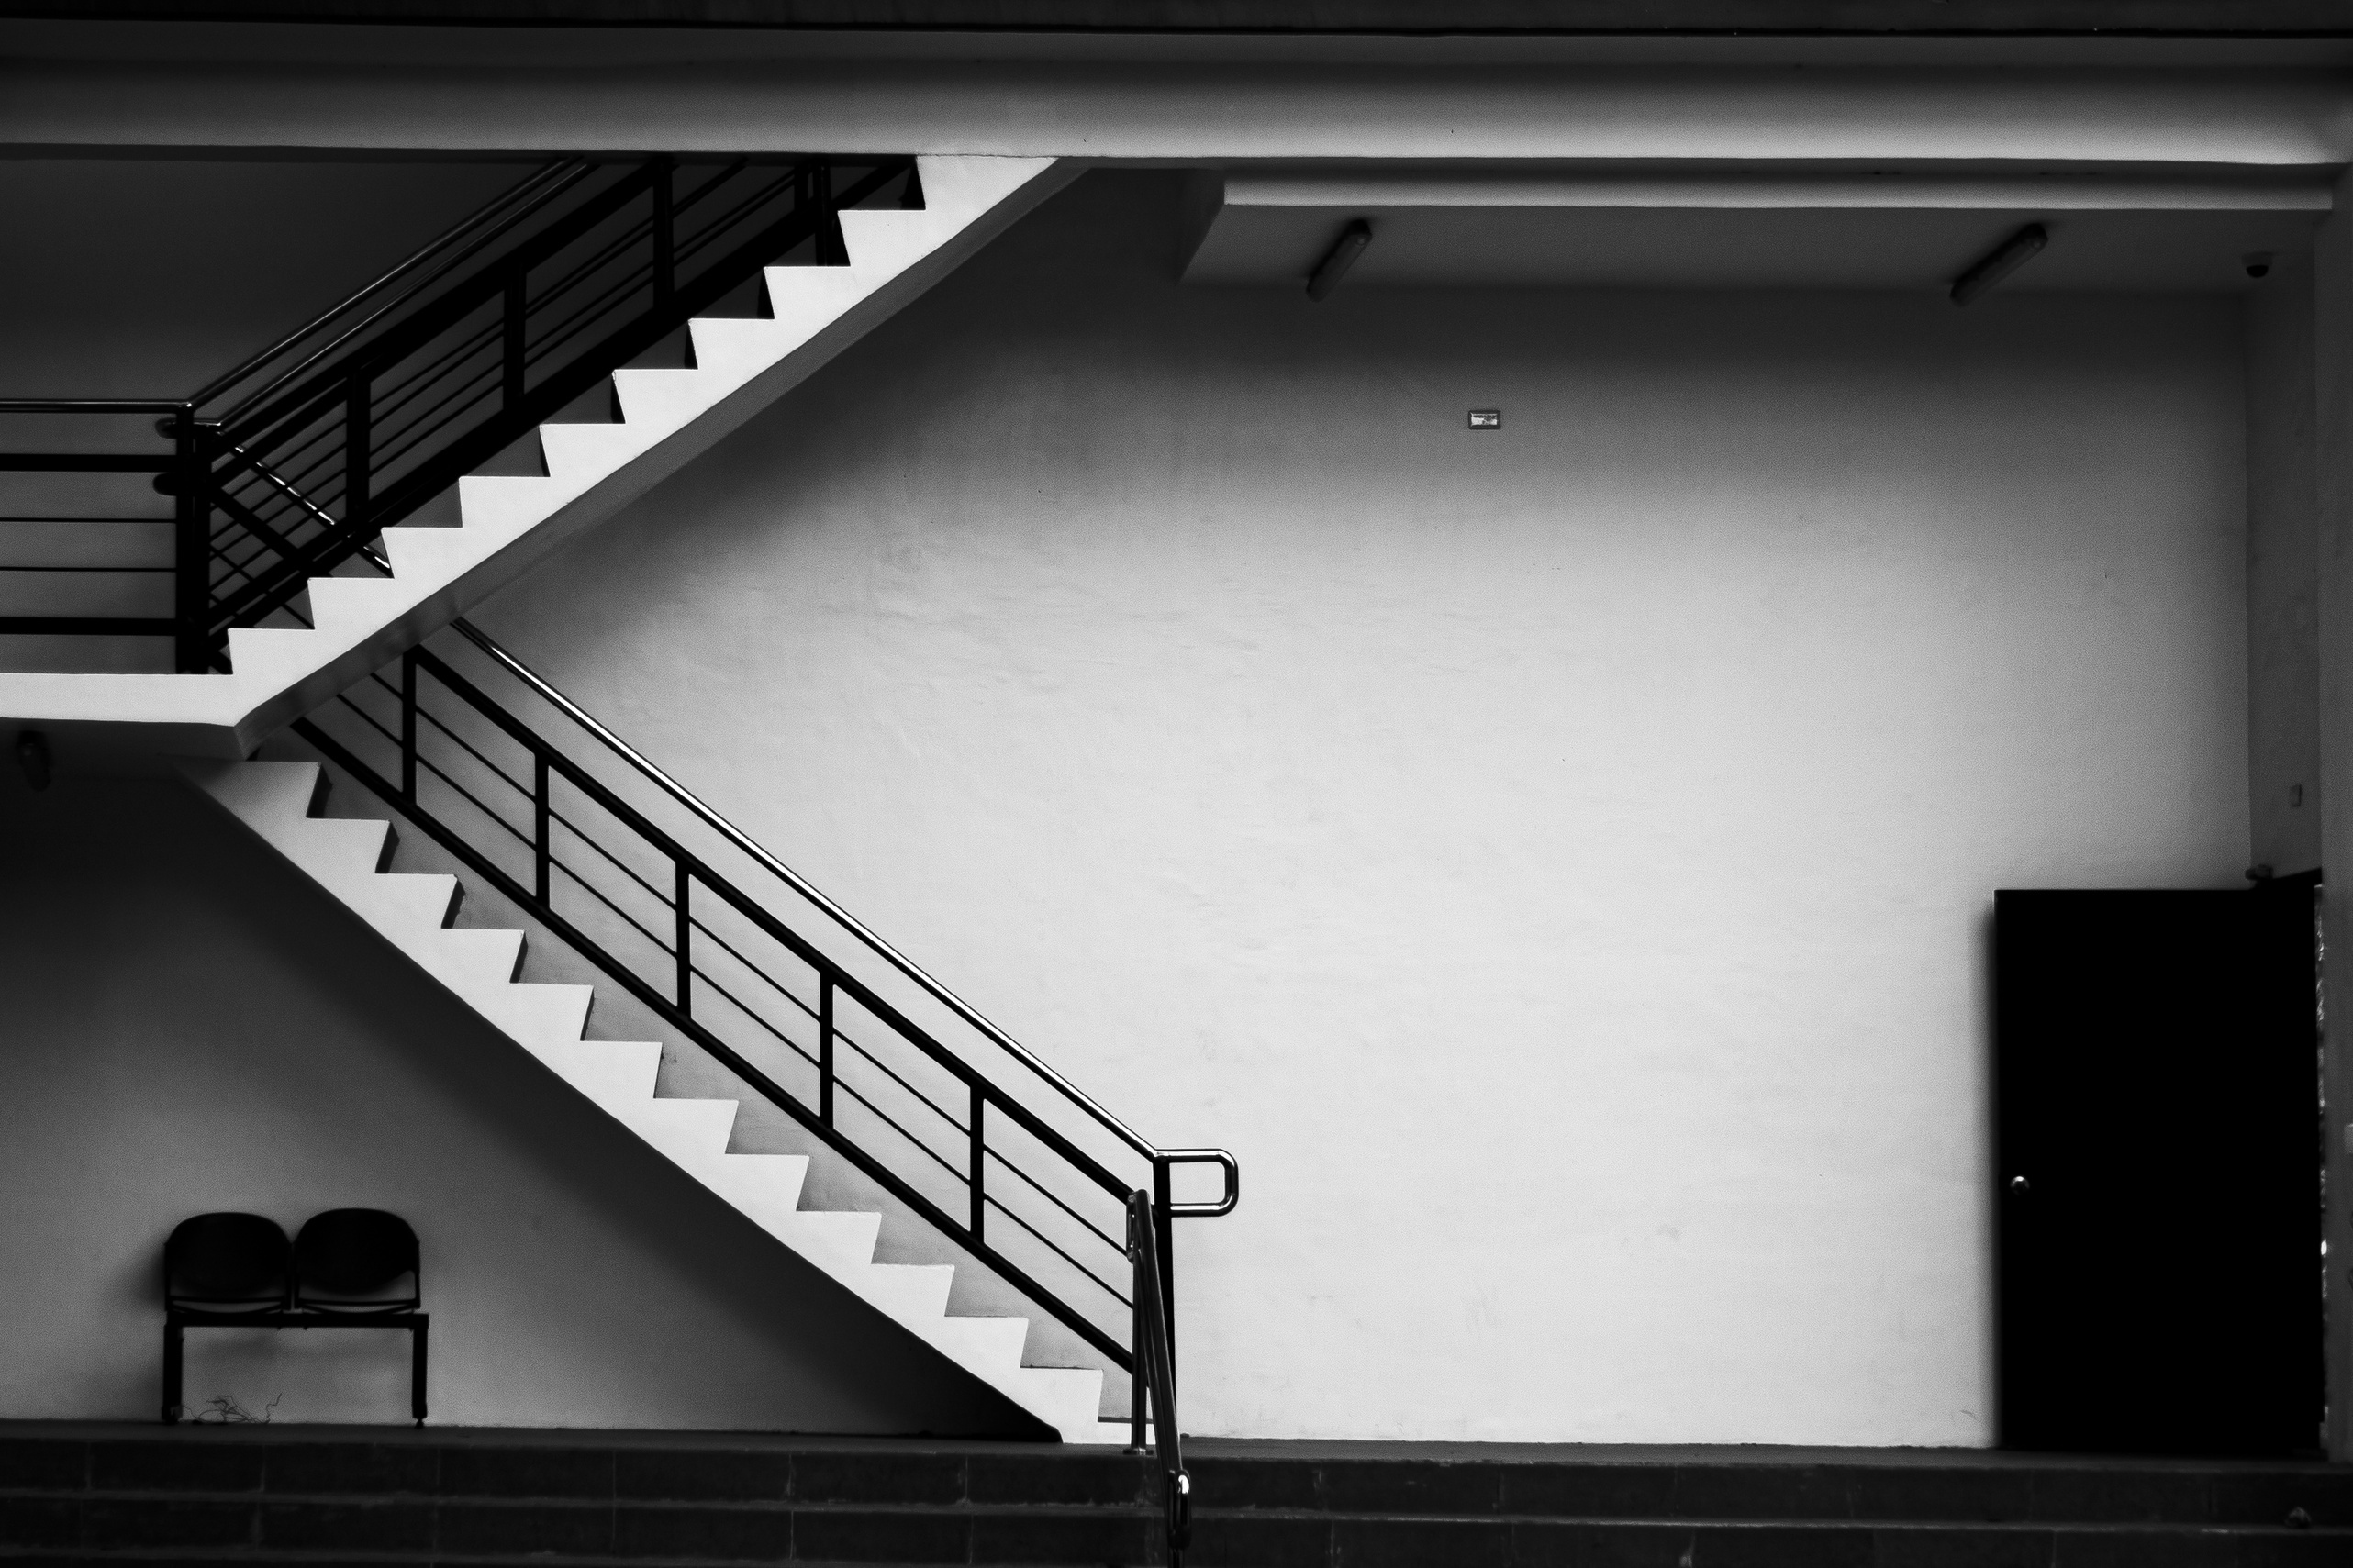

TABLE OF CONTENTS
01
02
03
04
05
06
07
08
Introduction
The Team
UML
Key Features
Design Patterns
Future Improvements
Questions
Thank you

Slide 3

INTRODUCTION
The Agile Board CLI is a command-line interface application designed for streamlined project management using Agile methodologies. It offers a concise and efficient way to create, manage, and track tasks on an Agile board, allowing teams to easily collaborate and stay organized. With intuitive commands, it enables users to add, prioritize, and update tasks effortlessly, fostering agile development practices in a text-based environment. Enhance your team's agility and productivity with the Agile Board CLI.

Slide 4

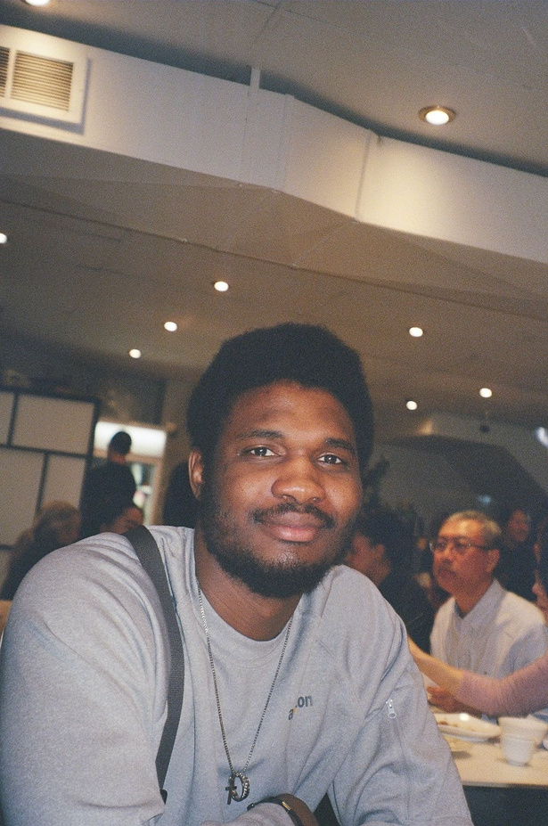
THE
TEAM
NIMISH
SHARMA
OLAYINKA
OLASUNKANMI

Slide 5
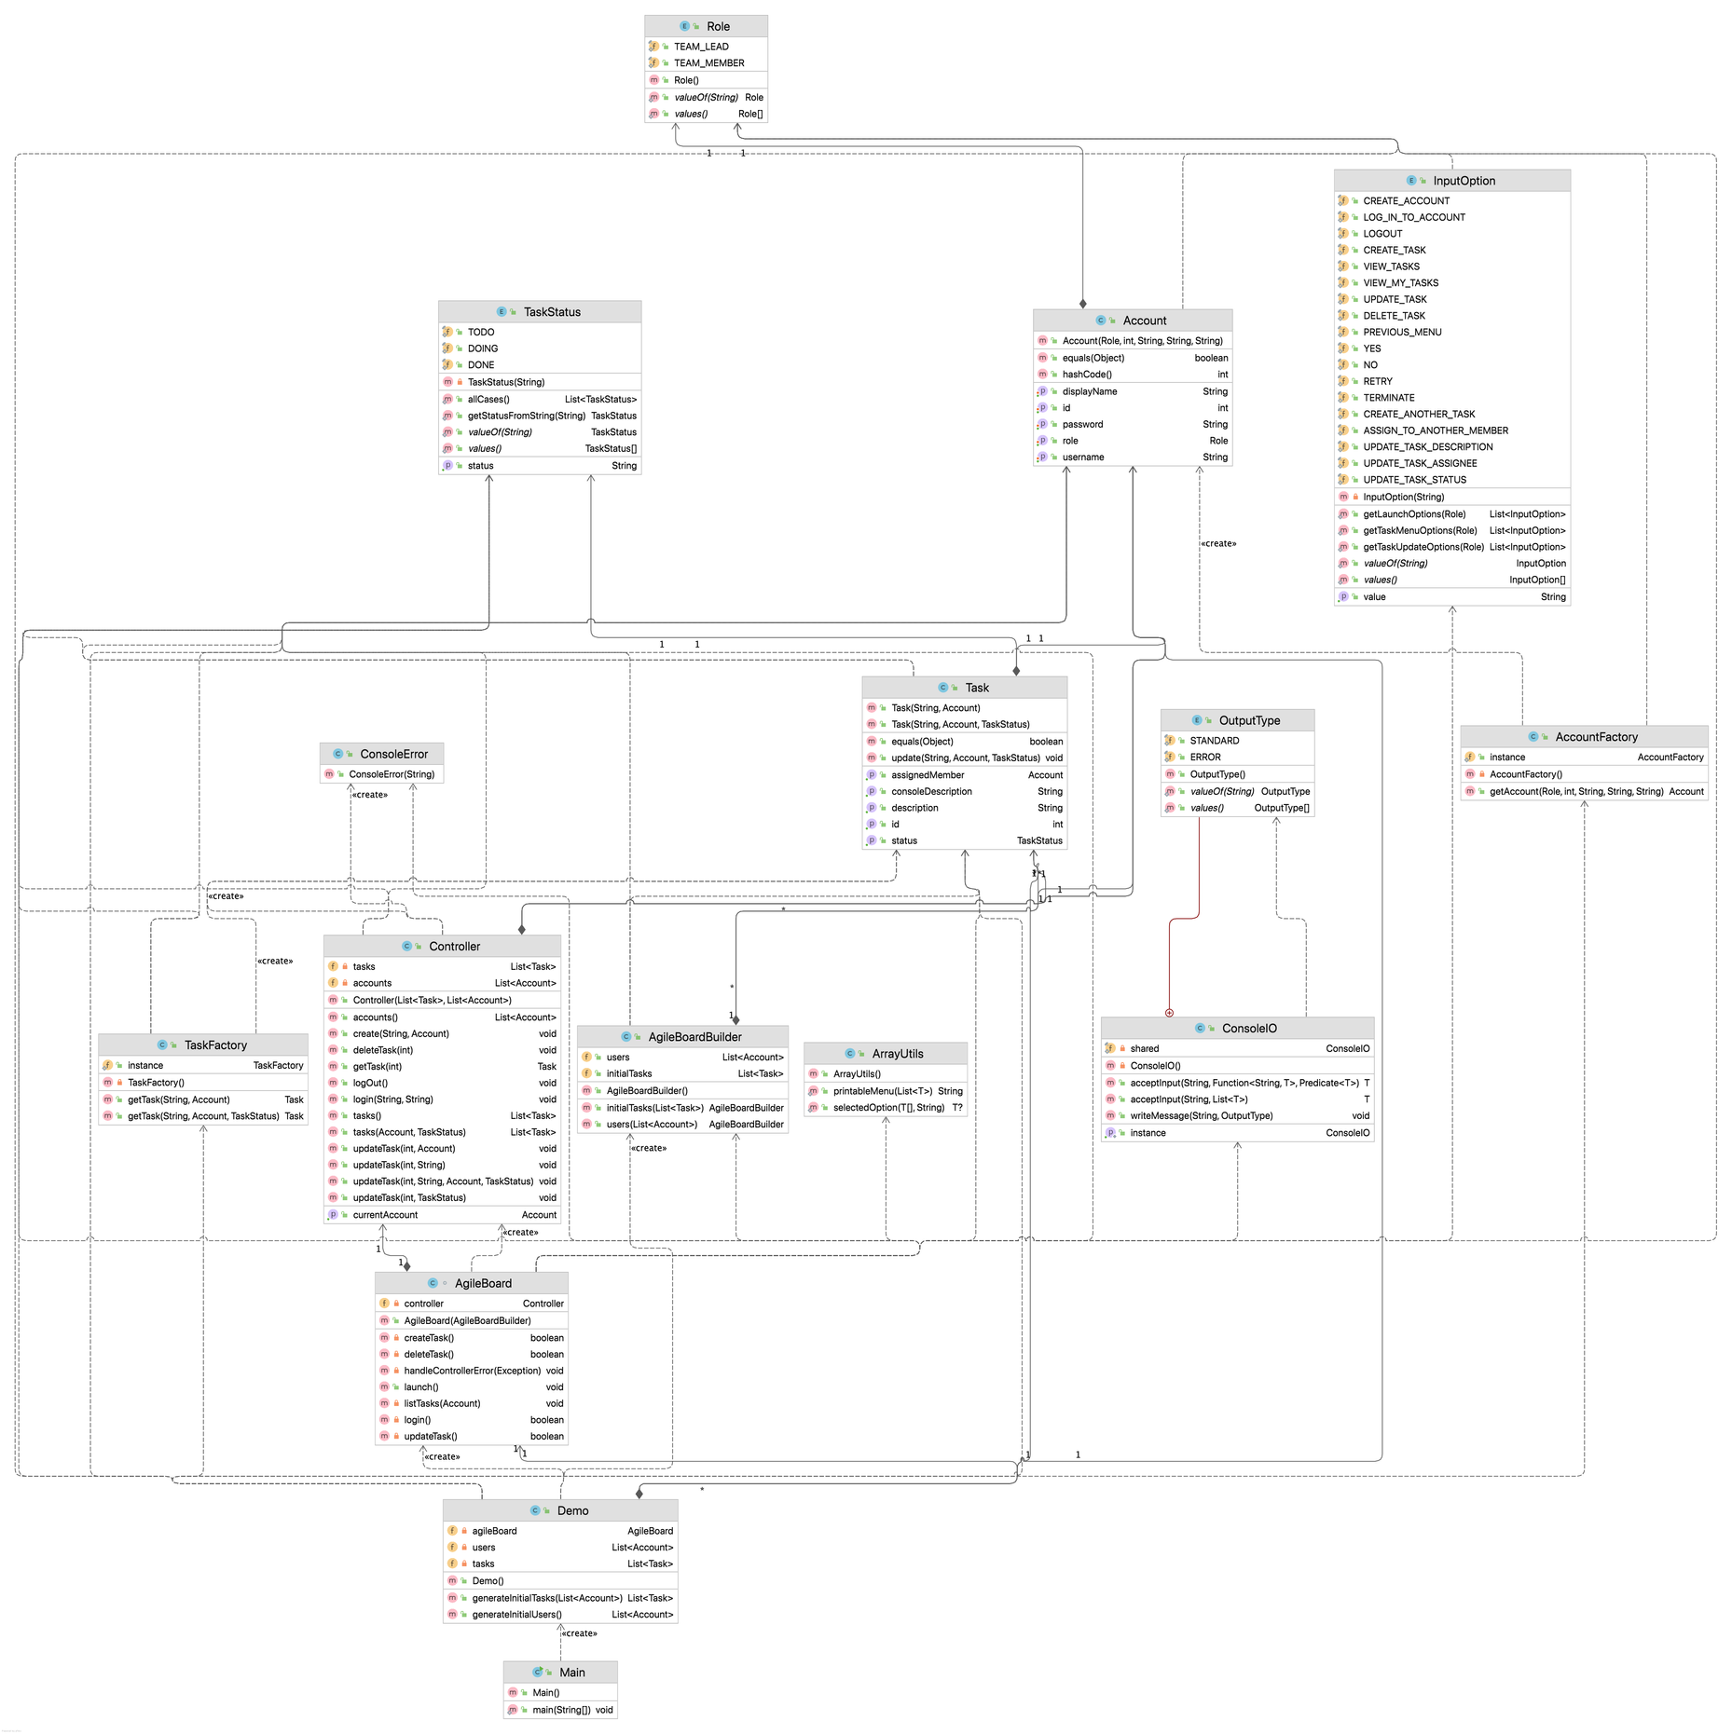
UML
DIAGRAM

Slide 6
TASK
Task should have the following:
description: String
status: ENUM TODO/DOING/DONE
id: int
assignedMember: Account
USER ACCOUNT
Key Features
User account should have:
role: ENUM TeamLeader/TeamMember
id: int
username: String
password: String
displayName: String
TEAM LEADER ROLE
A team lead should be able to:
Create tasks
View all tasks
Delete tasks
Update task description and assignedMember
TEAM MEMBER ROLE
A team member should be able to:
view tasks assigned to them
update tasks status

Slide 7
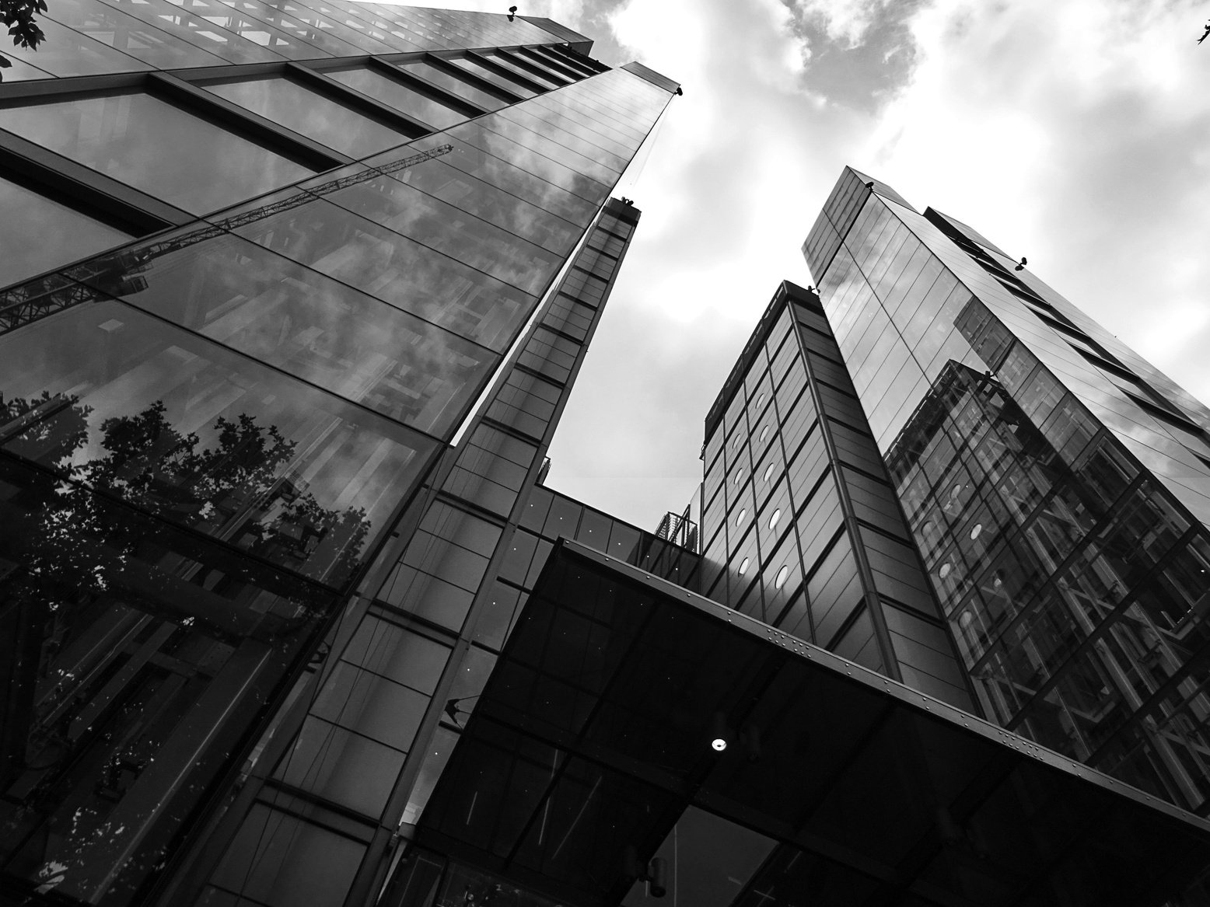

Design Patterns
MVC
Singleton Factory
he Model-View-Controller pattern is used to separate the application into three interconnected components to achieve modularity and maintainability. This is used in the entire project design structure.
This combine singleton and factory pattern to the factory class has only one instance while producing a factory that manages object creation. This is used in the account and task and creation.

Slide 8
Design Patterns
Facade
Builder
This structural design pattern provides a simplified and unified interface to a set of interfaces in a subsystem, making it easier to use and understand. This is used in ConsoleIO class using imported java.utils Interfaces.
The creational design pattern separates the construction of a complex object from its representation, allowing the step-by-step creation of different configurations of the object using the same construction process. This is used in initializing and building the agile board.

Slide 9



FUTURE IMPROVEMENTS
These are planned or potential future improvements showing our commitment to continuous improvement and staying aligned with evolving Agile practices
Add backend controller to create new user accounts for different type of roles
Add a GUI for easy use and visualization of application compared to a CLI
Upgrade project to make use of a RDB and ORM framework to store accounts and tasks data
BACKEND
GUI
DATABASE

Slide 10

QUESTIONS
The floor is open to any questions, challenges, or ideas you would to suggest

Slide 11
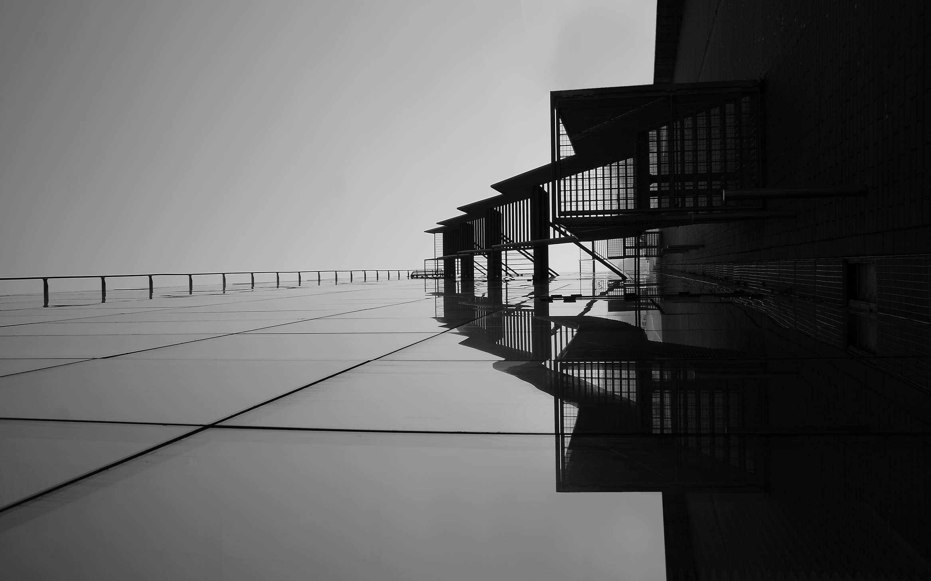

Thank you

